Slide 1
16844 Protein
ImageJ

Slide 2
Tubulin/DAPI
16844-mNG
Composite

Slide 3
Excel – Western Blot

Slide 4
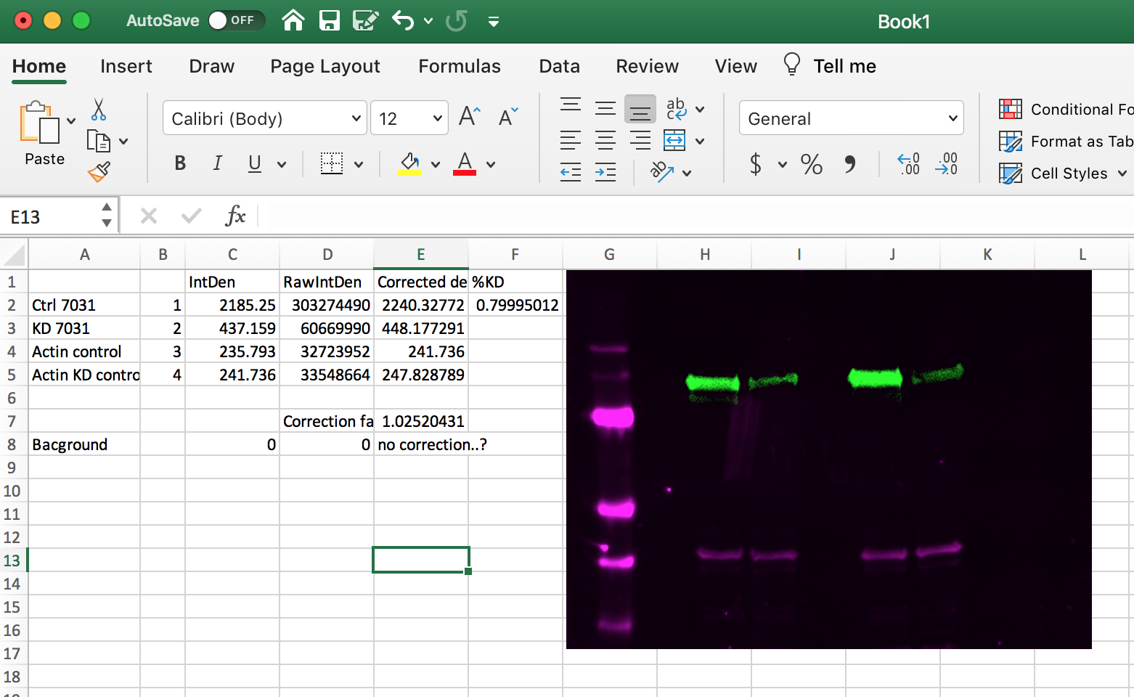

Slide 5
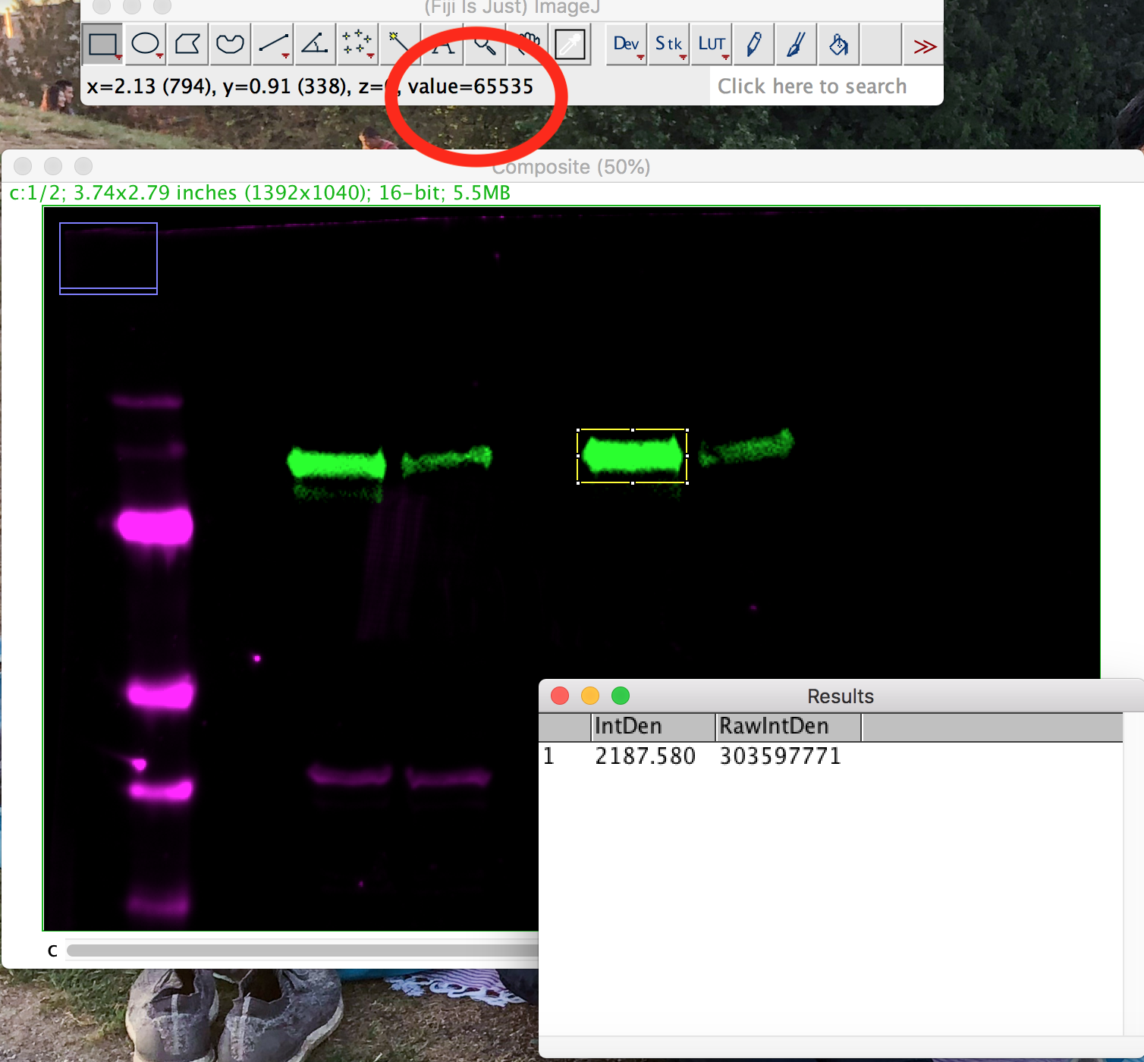
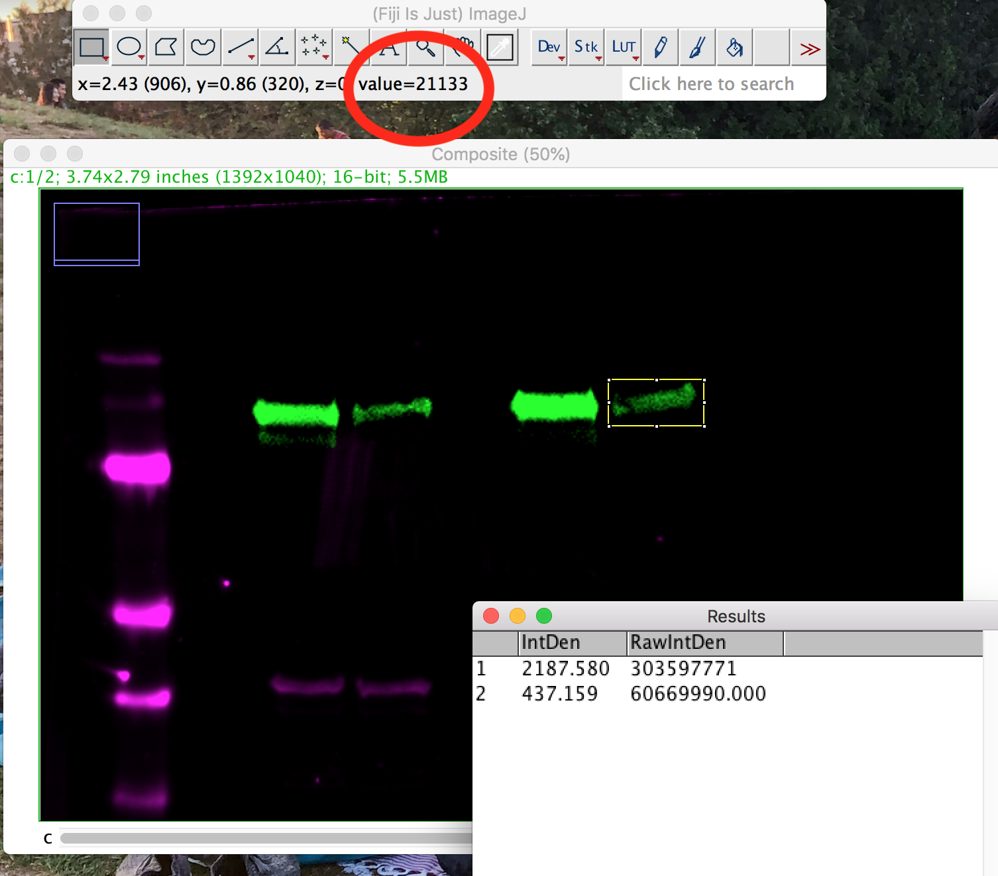
Note: I had some really bright intensities for the experimental and control protein
Dr. Paradez’s values for the control was ~7000 but mine was almost 10X that

